Slide 1
Project Title -AIRBNB HOTEL BOOKING ANALYSIS
Surya Omar
STU6776a025447941735827493

Slide 2

PROBLEM STATEMENT
The hospitality and travel sector faces increasing competition and dynamic customer behavior. Airbnb and hotel service providers collect large amounts of booking data but often lack actionable insights to improve operations, pricing, and customer satisfaction. Without a clear understanding of booking trends, cancellation patterns, and customer preferences, businesses risk revenue loss, overbooking, and inefficient resource allocation.
This project aims to analyze Airbnb hotel booking data to uncover hidden patterns and key factors influencing bookings and cancellations. By leveraging data-driven insights, hospitality providers can optimize pricing strategies, forecast demand, reduce cancellations, and enhance customer experiences.

Slide 3

Project Description
The Airbnb Hotel Booking Analysis project focuses on examining hotel booking data to uncover valuable trends and insights. It studies customer demographics, pricing behavior, seasonal demand, and cancellation patterns to understand the key factors influencing bookings. Using Python and data visualization tools, the project performs thorough data cleaning, preprocessing, and exploratory data analysis to ensure accurate results. This approach highlights patterns in customer preferences and booking behavior over time. The findings help in optimizing pricing strategies and forecasting demand more effectively. By identifying reasons for cancellations, the project suggests ways to reduce them and improve operational efficiency. It also supports better resource allocation for hospitality providers. Through data-driven insights, the project enhances decision-making for revenue management and guest satisfaction. Ultimately, it empowers hospitality businesses to stay competitive in a rapidly changing market. This project serves as a model for applying analytics to improve services and outcomes in the travel and hotel industry.

Slide 4

WHO ARE THE END USERS?
The end users for the Airbnb Hotel Booking Analysis project are primarily:
Hotel and Airbnb managers who need insights to optimize pricing, manage bookings, and improve occupancy.
Revenue management teams aiming to forecast demand, reduce cancellations, and maximize profits.
Marketing and customer experience teams looking to understand customer preferences and seasonal trends.
Hospitality analysts and data-driven decision-makers who use analytics to improve operational efficiency and guest satisfaction.
In short, anyone in the hospitality industry involved in booking management, pricing strategy, and customer experience can benefit from this project.

Slide 5

Technology Used
Python – for data cleaning, preprocessing, and analysis.
Pandas & NumPy – for data manipulation and numerical operations.
Matplotlib & Seaborn – for data visualization and trend analysis.
Scikit-learn (optional) – for any predictive modeling or pattern detection.
Google Colab – cloud-based Python environment for coding, analysis, and visualization without local setup.

Slide 6
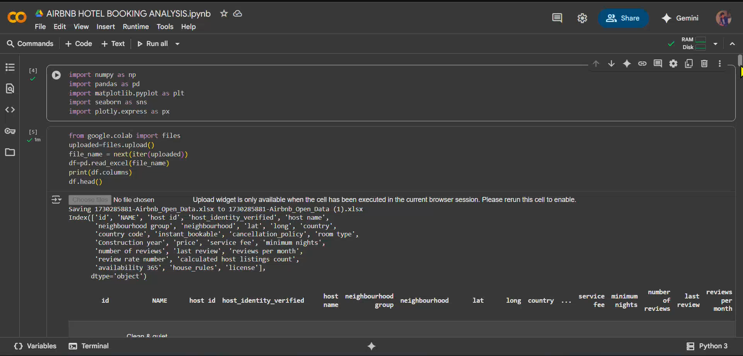
RESULTS1
[Add screen shots of your code or Chart(s) ]

Slide 7
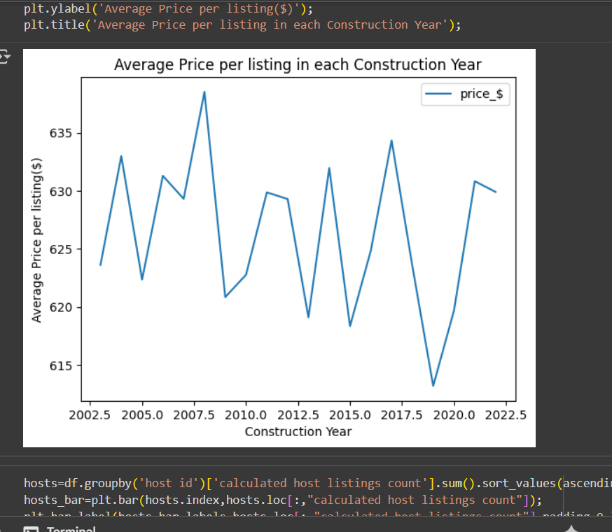
RESULTS2
[Add screen shots of your code or Chart(s) ]

Slide 8
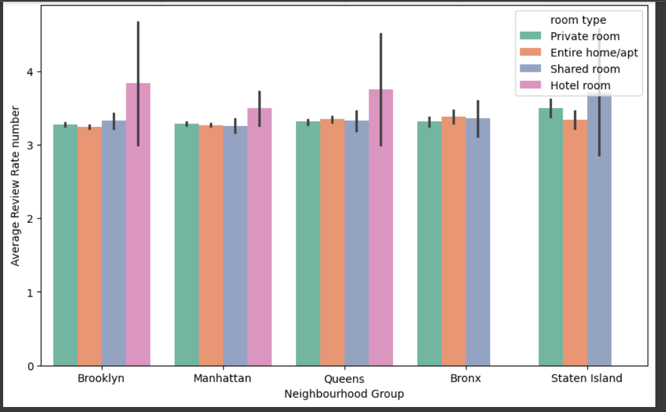
RESULTS3
[Add screen shots of your code or Chart(s) ]

Slide 9
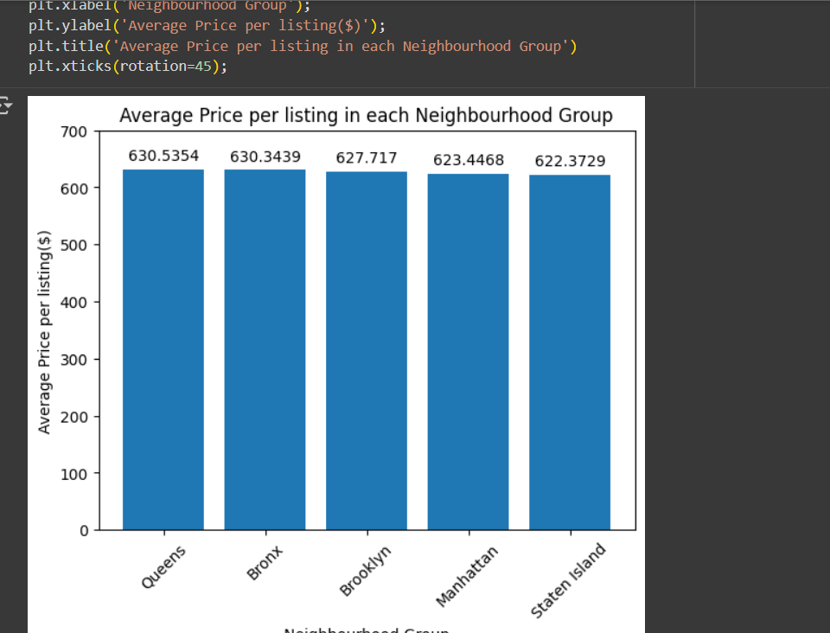
Result 4

Slide 10
GitHub repository
Create github repository
VOIS_AICTE_Oct2025_Surya-omar
https://github.com/surya323-ma/VOIS_AICTE_Oct2025_Surya-omar
https://github.com/surya323-ma/VOIS_AICTE_Oct2025_Surya-omar

Slide 11
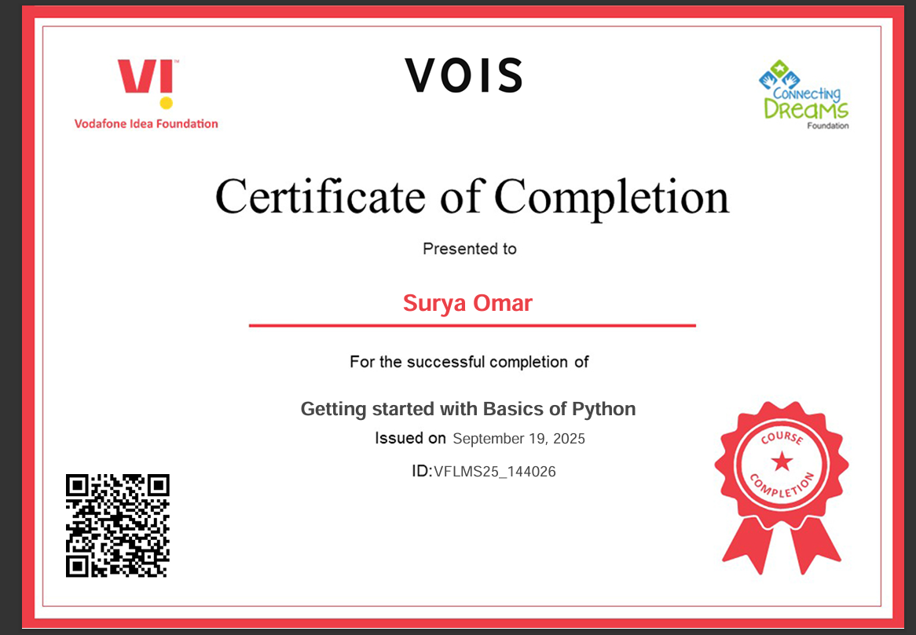
Getting started with Basics of Python Certificate
[Paste your Certificate Here]

Slide 12
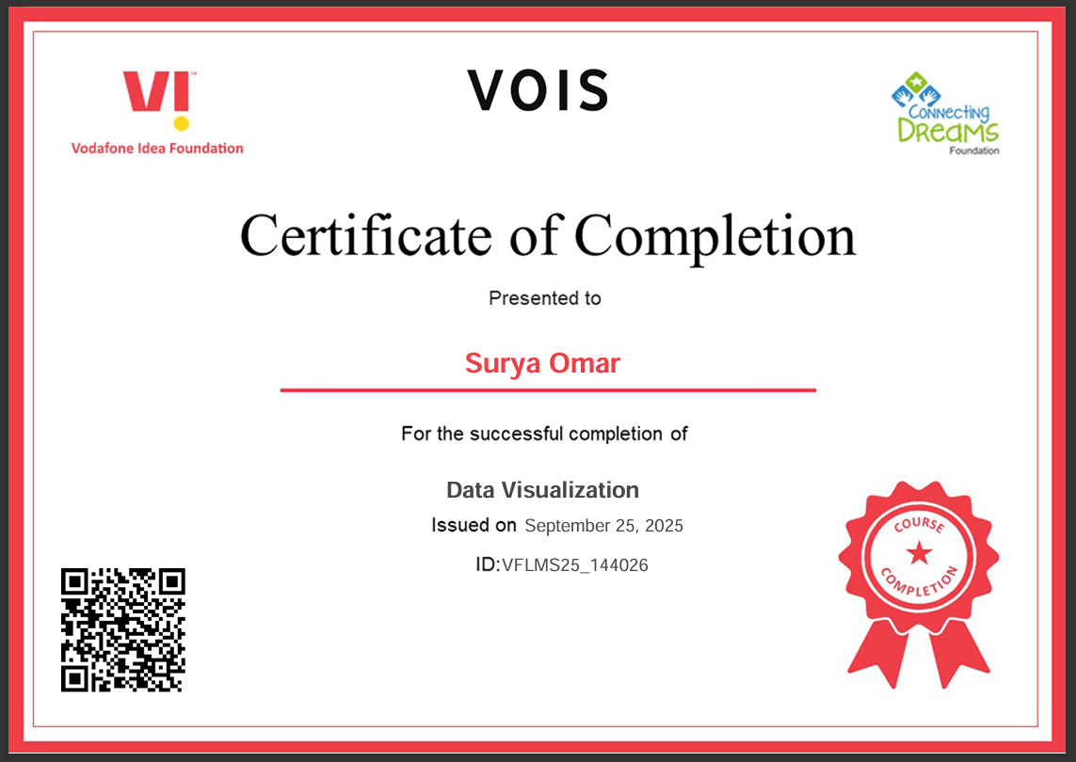
Data Visualization Certificate
[Paste your Certificate Here]

Slide 13
Thank you
.
.

